Slide 1
Tech Talk Session
RESOURCE GOVERNOR IN SQL SERVER 2008
Manikandan

Slide 2
Resource Governor
Resource Governor is a new technology in SQL Server 2008 that enables you to manage SQL Server workload and resources by specifying limits on resource consumption by incoming requests

Slide 3
WHY A RESOURCE GOVERNOR?
Every DBA wants more control over resource usage on their SQL Server instances. Pressure comes from:
IT : reducing data center footprint, hosting more instances on less hardware
Other departments : sales, marketing, finance who want better performance
Customers : my web report timed out

Slide 4
WHAT IS THE RESOURCE GOVERNOR?
A technology that enables you to manage SQL Server workload and resources by specifying limits on resource consumption

Slide 5
Overall Picture: SQL Server 2005
workloads
Call Routing
Admin
Ad-hoc
Reports
Marketing
All Server Resources

Slide 6
Overall Picture: SQL Server 2008
Workloads, Batch Control
Ad-hoc
Call Routing
Admin
Marketing
Pool 2
Reports
Pool 1
All Server Resources

Slide 7
BEFORE RESOURCE GOVERNOR…
What we did before to control resource usage was inflexible and largely reactive:
Kill SPIDs with “runaway” queries
utilize SET QUERY_GOVERNOR_COST_LIMIT per query (or per instance with sp_configure)
use separate instances with affinity to separate workloads
juggle scheduled jobs to avoid peak activity times
schedule creation / destruction of procedures or even changing passwords to block certain groups during peak load times

Slide 8
WHAT ARE THE GOALS?
To classify and prioritize workloads
To make resource usage more balanced and predictable
To help prevent, or at least to minimize, the “run away query”
To monitor and adapt the above tactics to further smooth resource usage

Slide 9
THREE COMPONENTS OF RESOURCE GOV.
Resource pools.
Two resource pools (internal and default) are created when SQL Server 2008 is installed.
Workload groups.
Two workload groups (internal and default) are created and mapped to their corresponding resource pools when SQL Server 2008 is installed.
Classifier.
T here are internal rules that classify incoming requests and route them to a workload group.

Slide 10
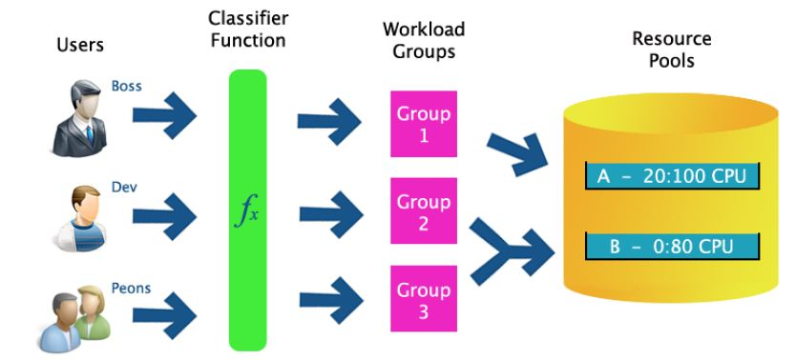
HOW DO THEY WORK TOGETHER?

Slide 11
WHAT ARE THE BASIC STEPS?
Create resource pools
Create workload groups
Create classifier function
Enable resource governor
Monitor and adapt

Slide 12
WHAT IS A RESOURCE POOL?
Provides a “slice” of a SQL Server instance’s resources (min/max CPU, memory, or both)
Pools can overlap or be isolated
% of resources based on amount “left over” –not being used by internal processes
Allows for aggregate monitoring of all requests utilizing the pool
These are simply the resources that are available to SQL Server, the highest layer of the governor
There are two pools by default, both of which are not removable
Internal – SQL Internal Session
Default – All Other Connections

Slide 13
RESOURCE POOL SYNTAX
CREATE RESOURCE POOL pool_name
[ WITH
( [
MIN_CPU_PERCENT =value ][[,]
MAX_CPU_PERCENT =value ][[,]
MIN_MEMORY_PERCENT =value ][[,]
MAX_MEMORY_PERCENT =value ]
)];

Slide 14
WHAT IS A WORKLOAD GROUP?
This acts as a bucket for requests of a similar type (as defined by the “classifier function”) and to place constraints on those requests
Allows for aggregate monitoring of all requests from all the members of the group

Slide 15
WORKLOAD GROUP SYNTAX
CREATE WORKLOAD GROUP group_name
[ WITH
([
IMPORTANCE ={ LOW|MEDIUM|HIGH } ][[,]
REQUEST_MAX_MEMORY_GRANT_PERCENT =value][[,]
REQUEST_MAX_CPU_TIME_SEC =value][[,]
REQUEST_MEMORY_GRANT_TIMEOUT_SEC =value][[,]
MAX_DOP =value][[,]
GROUP_MAX_REQUESTS =value]
)][
USING { pool_name| "default"}
];

Slide 16
WHAT IS A CLASSIFIER FUNCTION?
User-defined scalar function that allows you to customize how incoming requests are routed
Function returns a workload group name, which tells Resource Governor which pool to associate the request with
Needs to be very efficient

Slide 17
SOME CLASSIFICATION EXAMPLES
You can segregate incoming requests using a whole slew of criteria:
LOGINPROPERTY (DefaultLanguage, DefaultDatabase)
ORIGINAL_DB_NAME()
HOST_NAME(), APP_NAME() *
CONNECTIONPROPERTY() –IP address, protocol, etc.
[S]USER_[S]NAME()
IS_SRVROLEMEMBER(), IS_MEMBER()
Also intrinsic functions, DATEPART, GETDATE(), etc.

Slide 18
CLASSIFIER FUNCTION EXAMPLE #1
Give sa high priority, and non-sa low priority
CREATE FUNCTION dbo.Classifier()
RETURNS SYSNAME
WITH SCHEMABINDING
AS
BEGIN
RETURN (SELECT CASE SUSER_SNAME()
WHEN ‘sa’ THEN ‘HighPriorityGroup’
ELSE ‘LowPriorityGroup’
END
);
END
GO

Slide 19
CLASSIFIER FUNCTION EXAMPLE #2
Give ad hoc Management Studio queries low priority during business hours, and high priority otherwise
CREATE FUNCTION dbo.Classifier()
RETURNS SYSNAME
WITH SCHEMABINDING AS
BEGIN
RETURN (SELECT CASE
WHEN APP_NAME() LIKE ‘%Management Studio%’
AND DATEPART(HOUR, GETDATE()) BETWEEN 9 AND 17
THEN ‘LowPriorityGroup’
ELSE ‘HighPriorityGroup’
END
);
END
GO

Slide 20
CLASSIFIER FUNCTION EXAMPLE #3
Give the high priory other then the LAN environment.
CREATE FUNCTION dbo.Classifier()
RETURNS SYSNAME
WITH SCHEMABINDING
AS
BEGIN
RETURN (SELECT CASE
WHEN CONNECTIONPROPERTY(‘Local_Net_Address’)
LIKE ‘192.168.2.%’ THEN ‘Group_With_Max_CPU_1_Percent’
ELSE ‘HighPriorityGroup’
END
);
END
GO

Slide 21
HOW DO I MONITOR?
New Perfmonobjects with lots of counters:
SQLServer: Resource Pool Stats
SQLServer: Workload Group Stats
New trace events (e.g. CPU Threshold Exceeded)
There are also new DMVs:
sys.dm_resource_governor_workload_groups
sys.dm_resource_governor_resource_pools
Sys.dm_resource_governor_configuration

Slide 22
WHAT ARE THE LIMITATIONS?
CPU / Memory only (no I/O yet)
2008 Database Engine only (no SSAS, SSRS, SSIS)
Single instance only
Short OLTP operations are immune to constraints
Lack of contention can also prevent enforcement
Cannot constrain “internal” processes
Must disable classification to modify classifier function(you can’t apply these changes to existing sessions)
Pool / group names are case sensitive
Enterprise Edition only!

Slide 23
DEMO

Slide 24
THANK YOU!

